Slide 1

Satellite Image Manipulation Detection in Generative AI Era
Matthew W Chapman, Newcastle University
Deepayan Bhowmik, Newcastle University
Andrew Tewkesbury, Airbus Defence and Space Ltd
Doreen S Boyd, University of Nottingham
Boguslaw Obara, Newcastle University

Slide 2
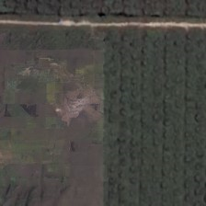
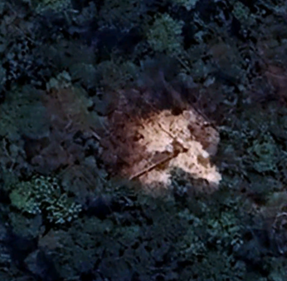
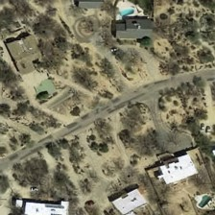
Real or Fake
Fake!
Fake!

Slide 3
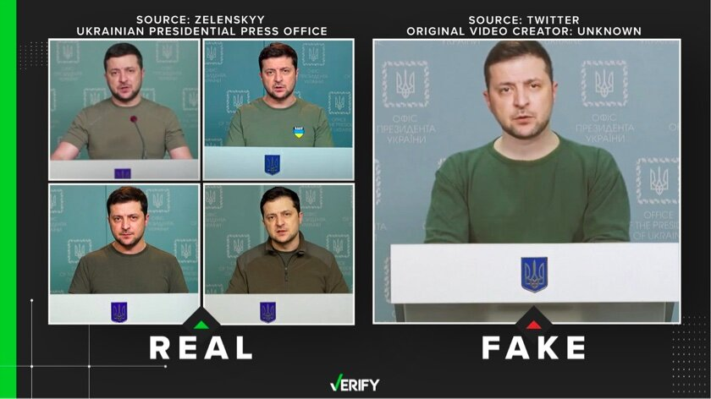
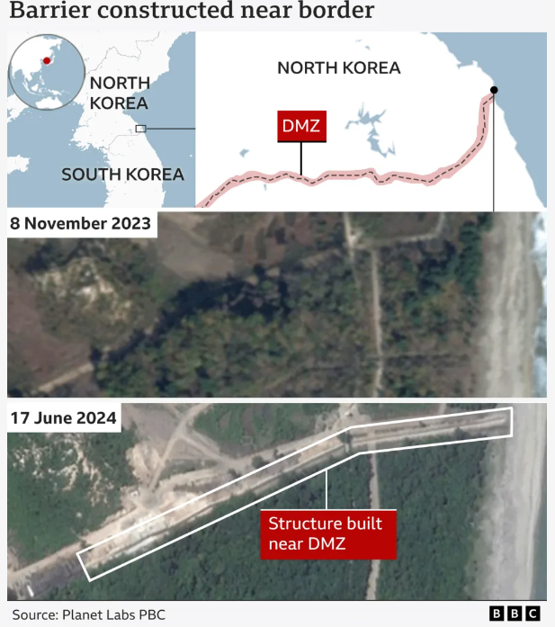
Background
AI leveraged manipulated satellite images are an emerging threat
Satellite images are becoming more prevalent in the media and on twitter
Deepfakes have also become more prevalent especially with current conflicts such as the war in Ukraine
Source: Nicholas Gerard Keeley
Source: BBC

Slide 4
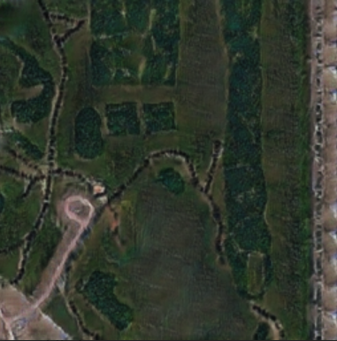
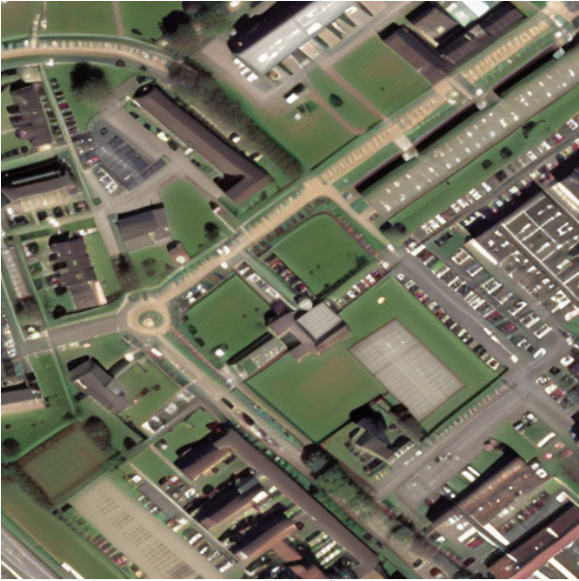
Research Gaps
There are a limited number of datasets publicly available containing AI-Generated satellite imagery.
There are no datasets publicly available containing satellite imagery that has been manipulated using AI
Created Using Diffusionsat-2024
Source: Bo Zhao-Deep fake geography? When geospatial data encounter Artificial Intelligence-2020

Slide 5
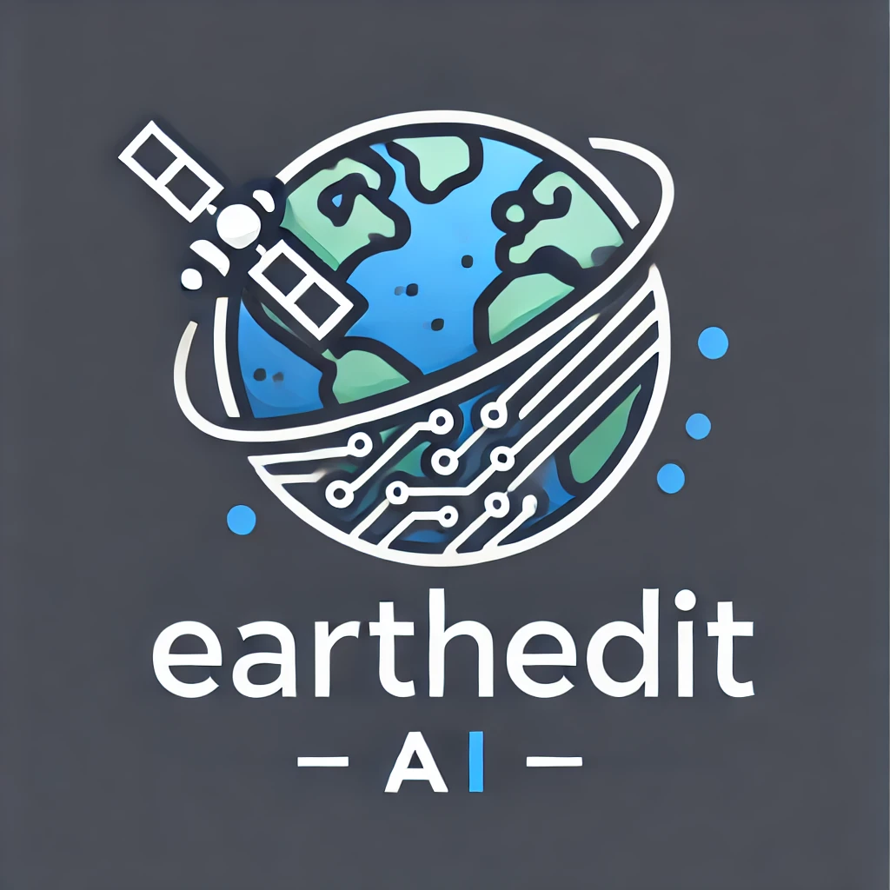
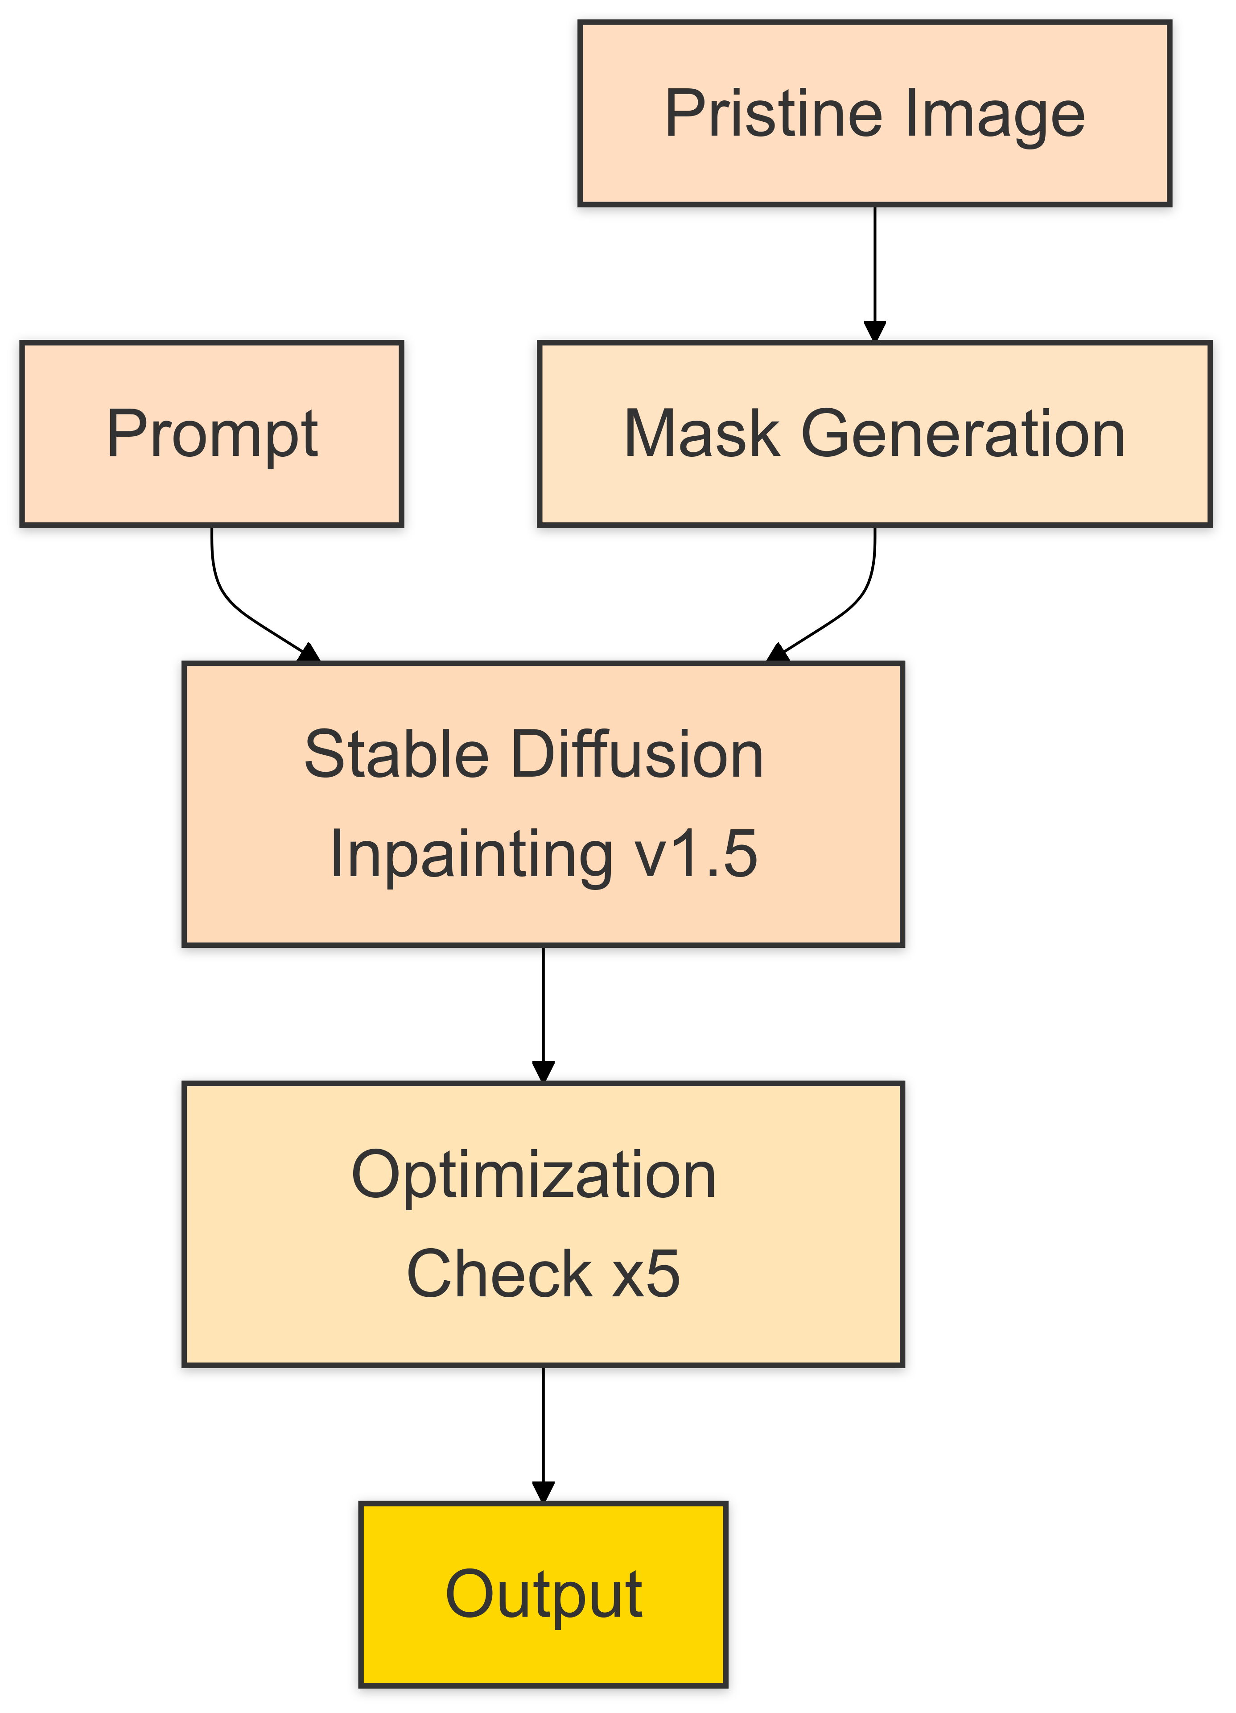
Image Manipulation System-EarthEdit

Slide 6
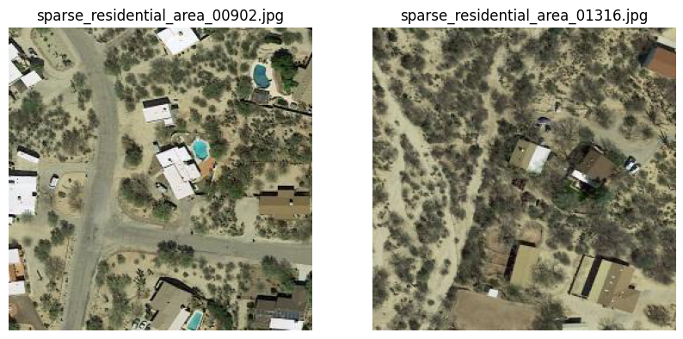
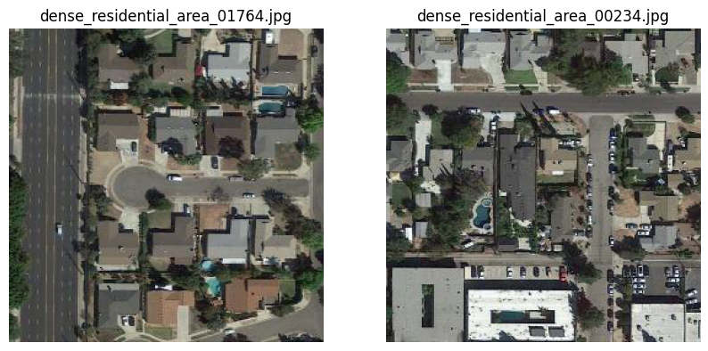
Pristine Dataset
MLRSNet was utilized
From a mixture of sources
Includes ultra-high-resolution satellite imagery such as GeoEye-1, WorldView-1, WorldView-2

Slide 7
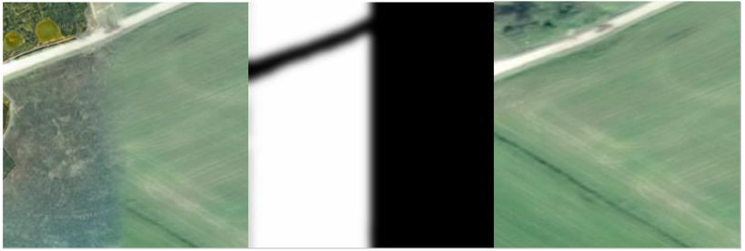
Mask Generation
Segment Anything (SAM) was used to create the mask
Controls were implemented, these varied for each scene classification
Guessian blur was also applied

Slide 8
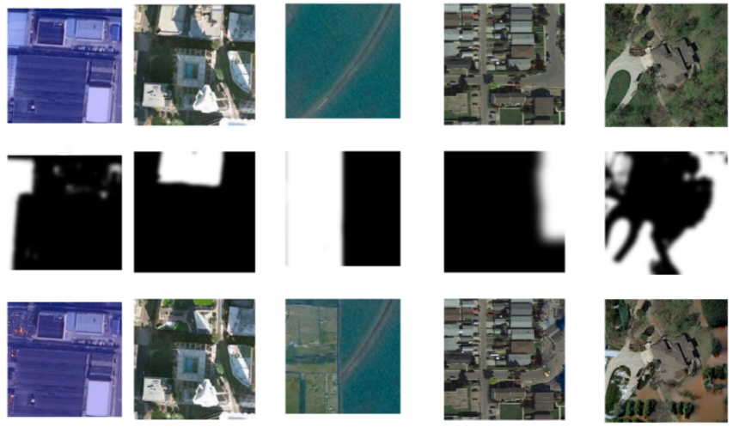
Inpainting
Runwayml/stable-diffusion-inpainting1.5 was utilized for inpainting
Prompts were selected at random

Slide 9
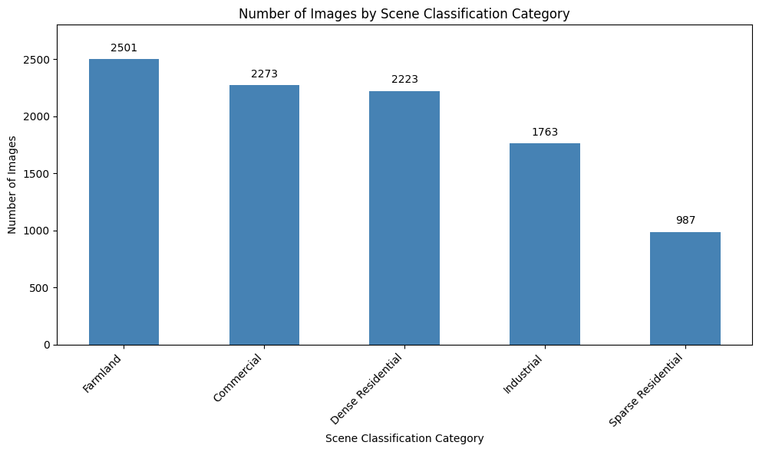
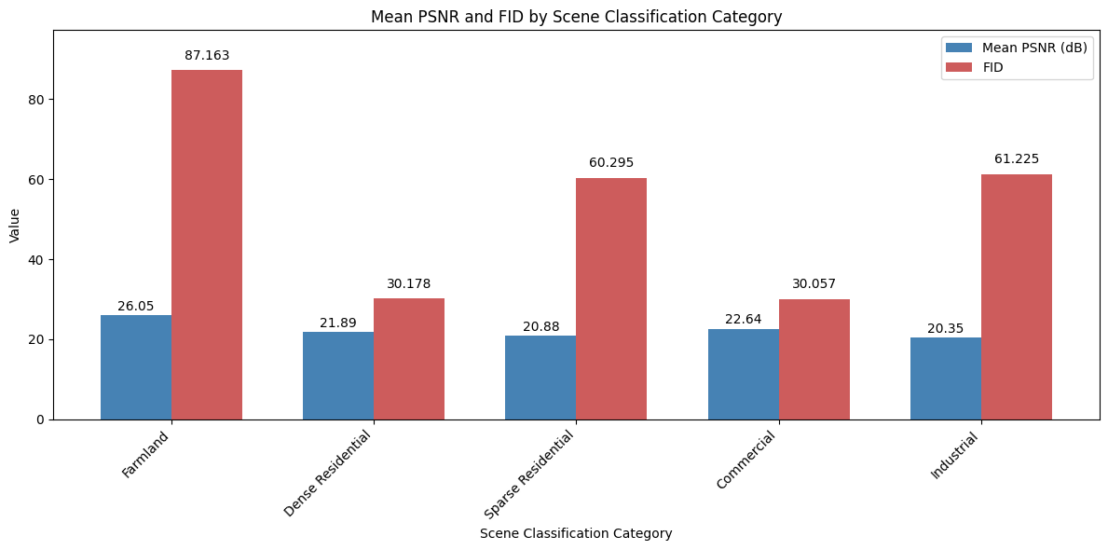
Dataset Generation Results

Slide 10
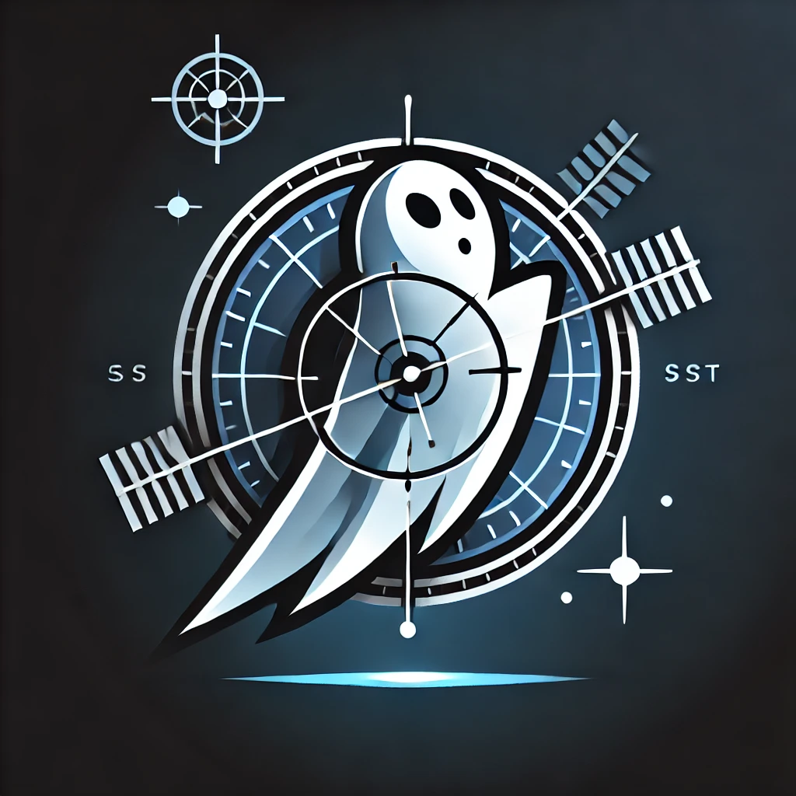
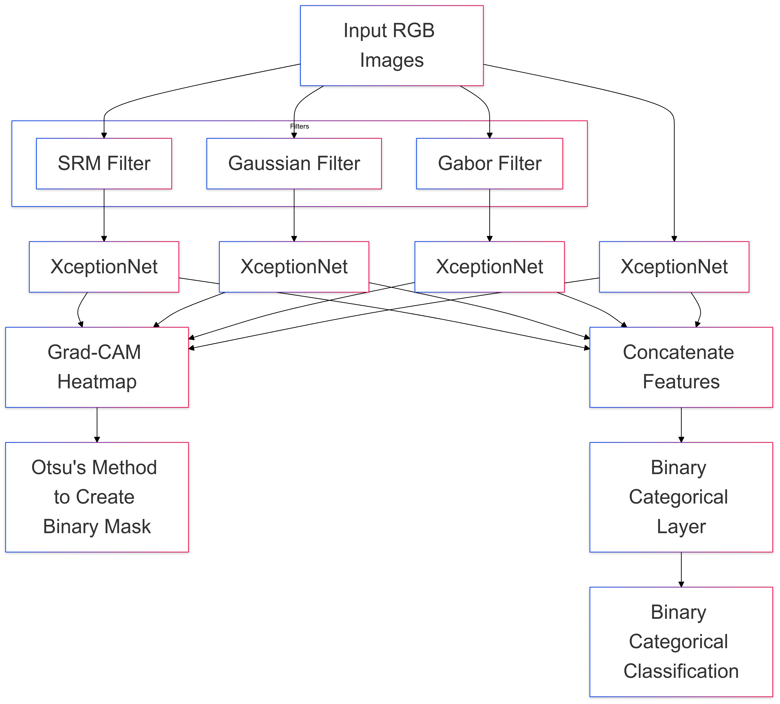
Detection System (PhantomNet)

Slide 11
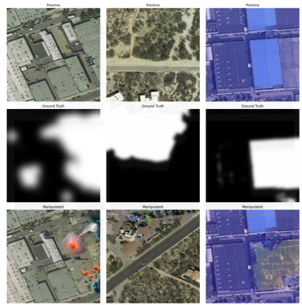
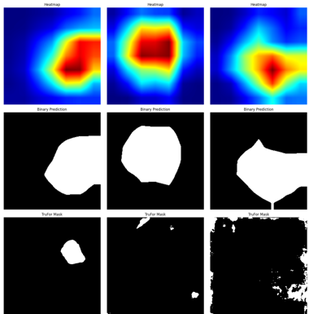
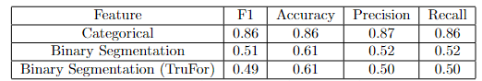
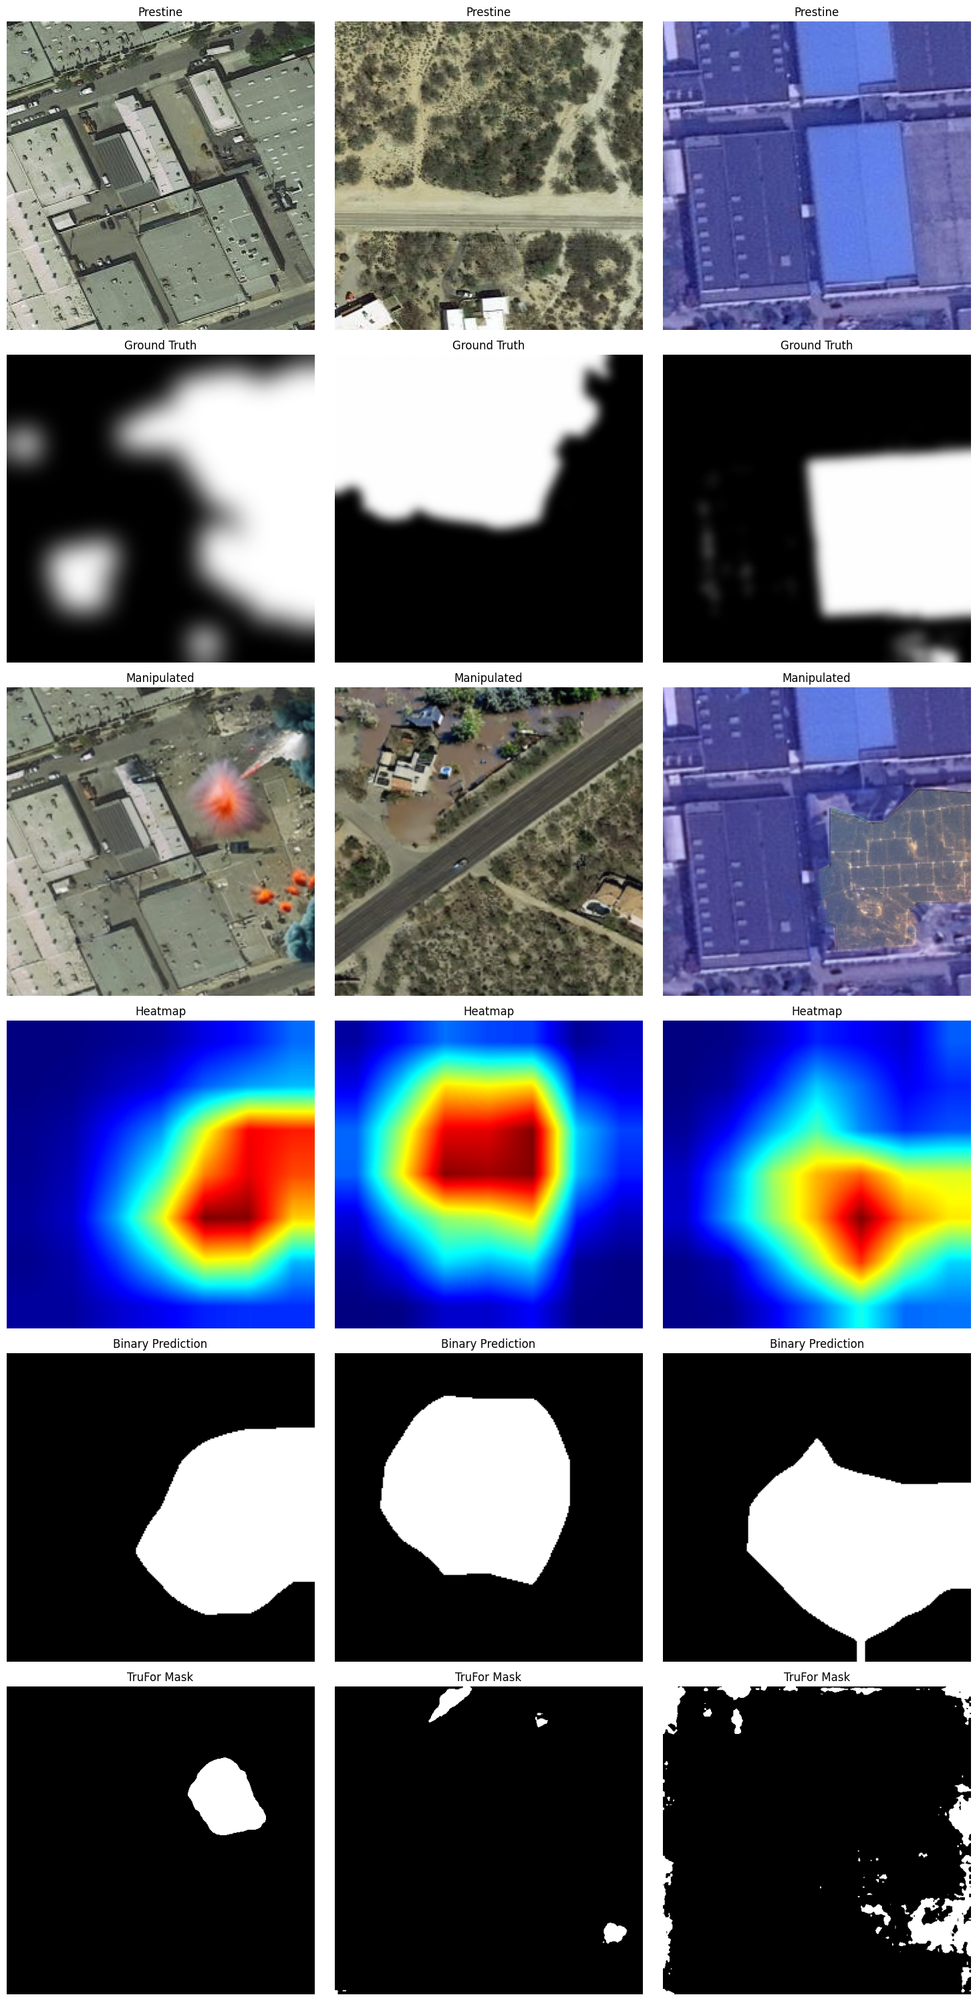
Phantomnet Results

Slide 12
Thanks, Any Questions?

